Slide 1
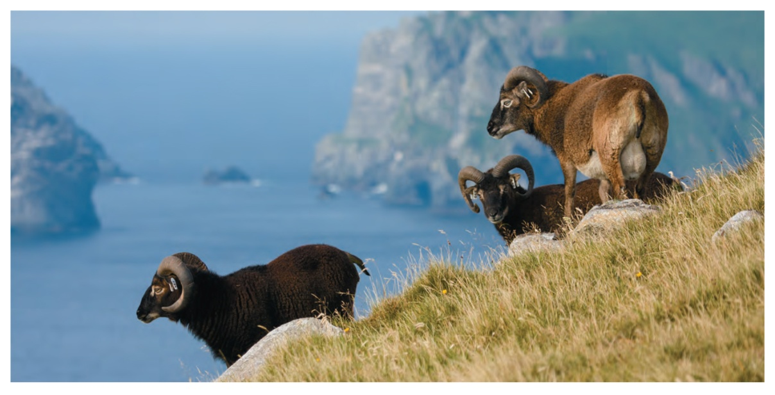
Mendelian Genetics in Populations: Selection and Mutation as Mechanisms of Evolution
Motivation
Can natural selection change allele frequencies and if so,
how quickly???
With the neo Darwinian synthesis:
microevolution = change of allele frequencies
Notes:
Chapter 6 Opener
Frequency of the dark color allele associated with the tyrosinase-related protein 1 has declined, along with the frequency of dark colored sheep

Slide 2
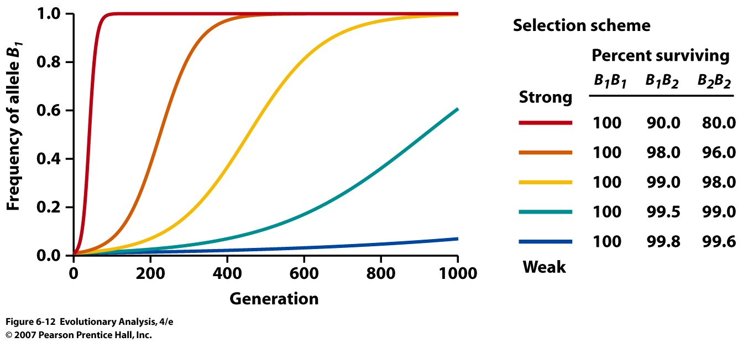
Can persistent selection change allele frequencies: Heterozygote has
intermediate fitness??????????
VERY QUICKLY!
Notes:
Figure 6.12 Persistent selection can produce substantial changes in allele frequencies over time
Each curve shows the change in allele frequency over time under a particular selection intensity.

Slide 3
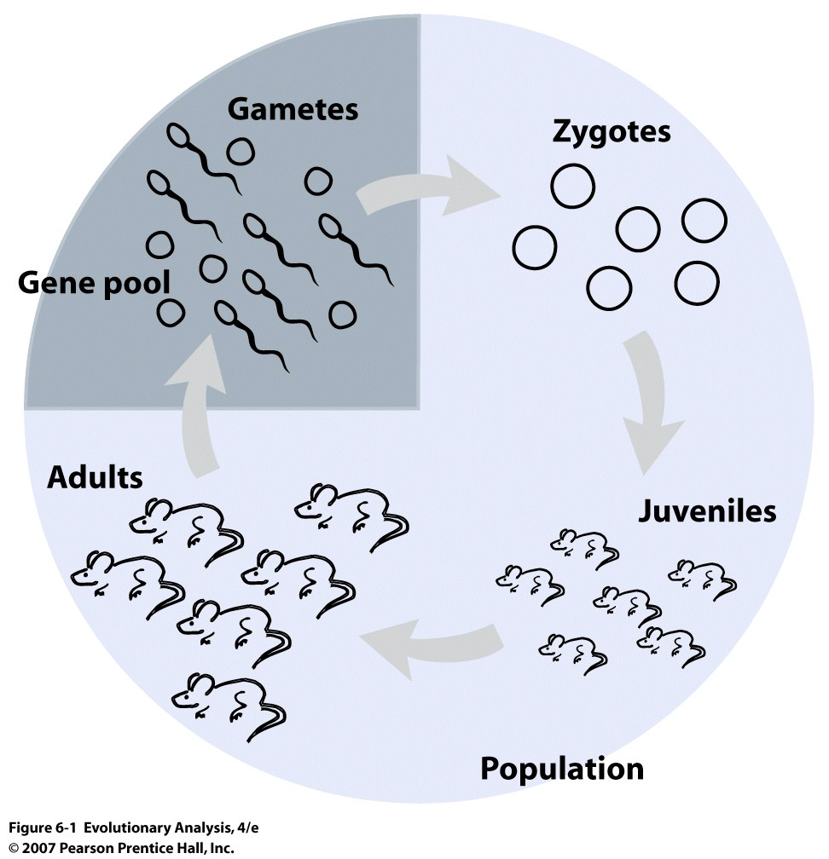
Developing
Population
Genetic
Models
Notes:
Figure 6.1 The life cycle of an imaginary population of mice, highlighting the stages that will be important in our development of population genetics.

Slide 4
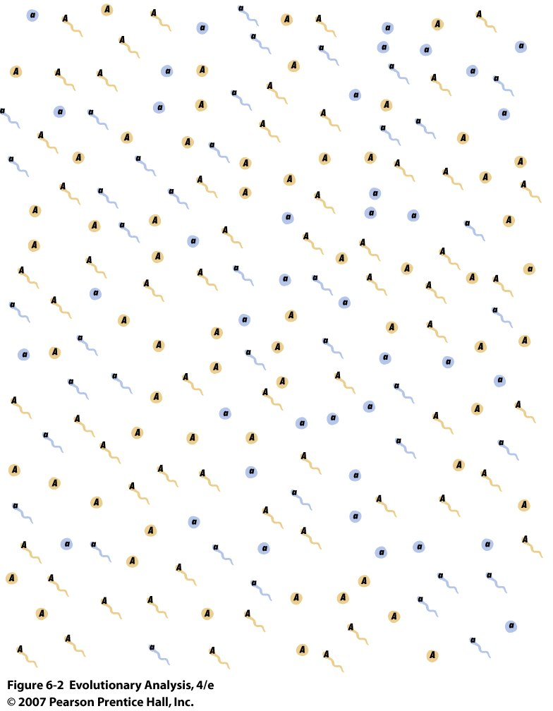
II. Null Situation, No Evolutionary Change
Hardy-Weinberg Equilibrium (parents: AA, Aa, aa)
Prob(choosing A) = p
Prob(choosing a) = q
Probability of various combinations of A and a = (p + q)²=
Notes:
Figure why doesn’t a dominant allele lead to phenotypes in a 3:1 ratio in populations. Question posed by Punnet (who worked with Bateson) to Hardy

Slide 5
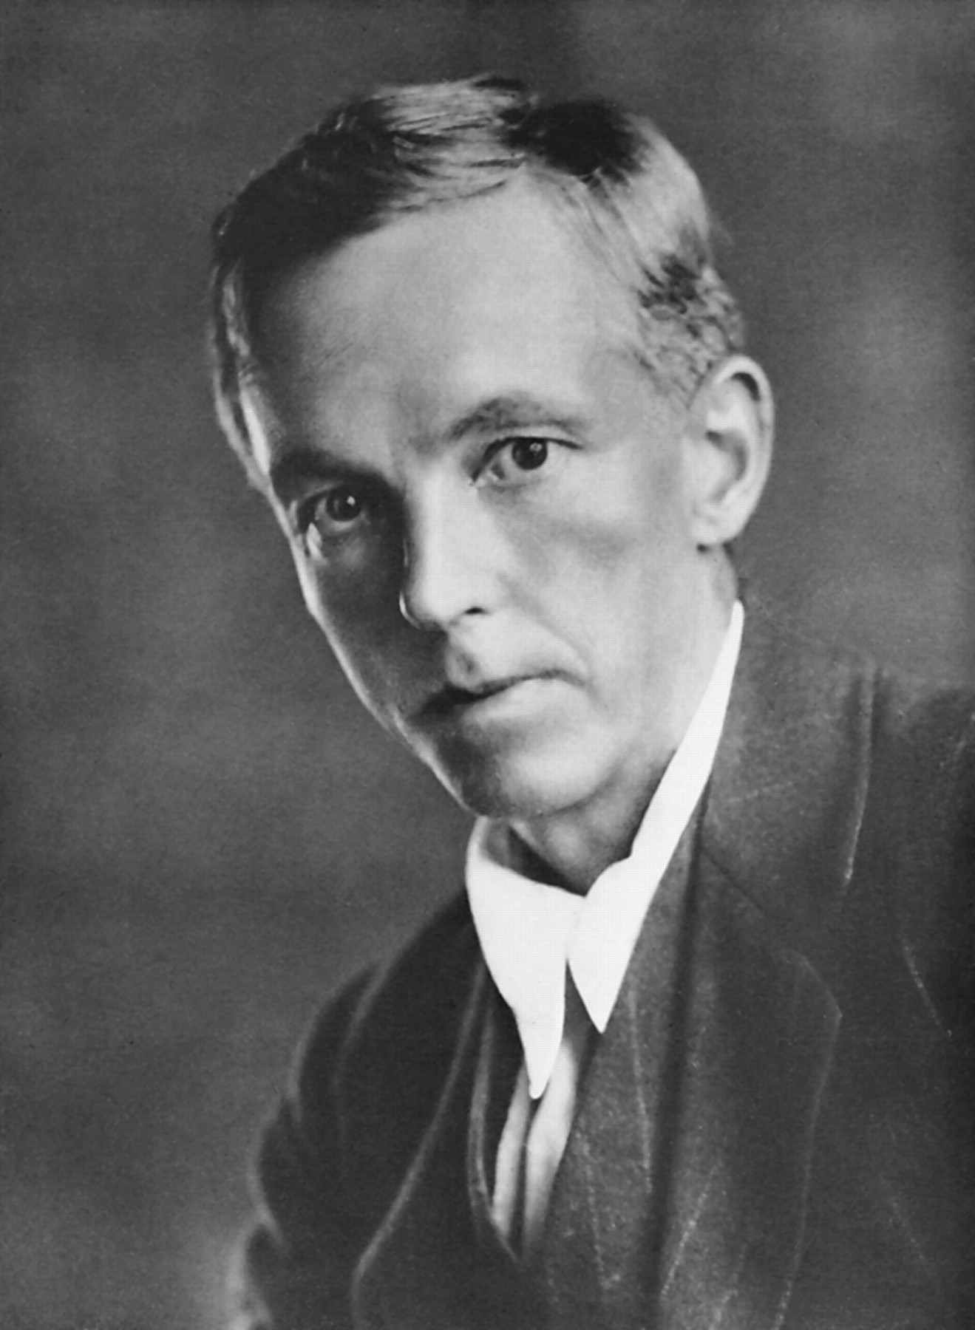
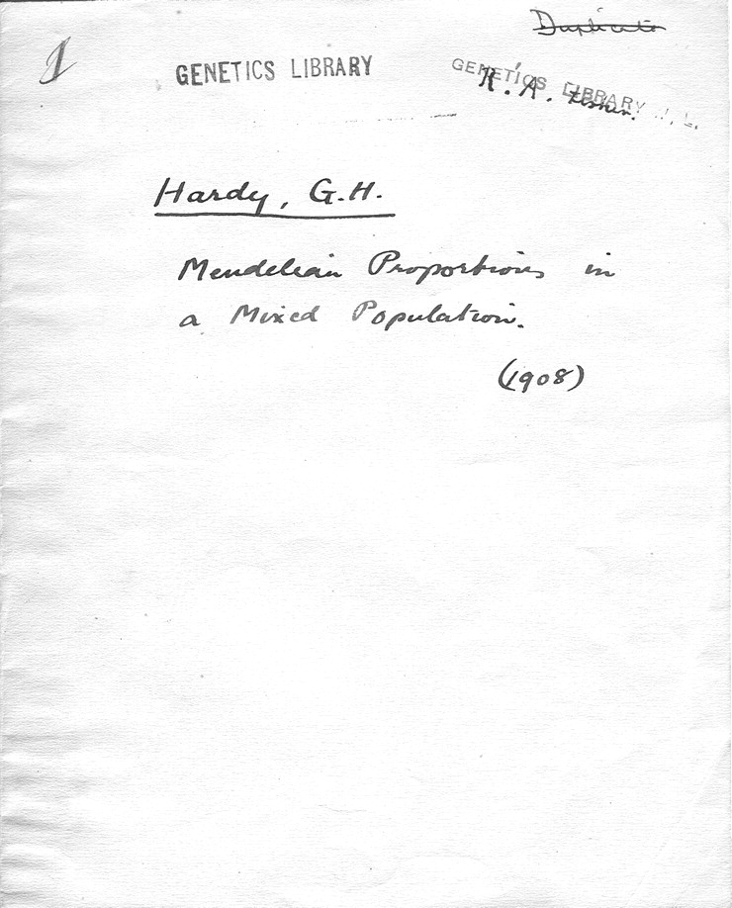
Punnett's copy of Hardy's letter to Science.

Slide 6
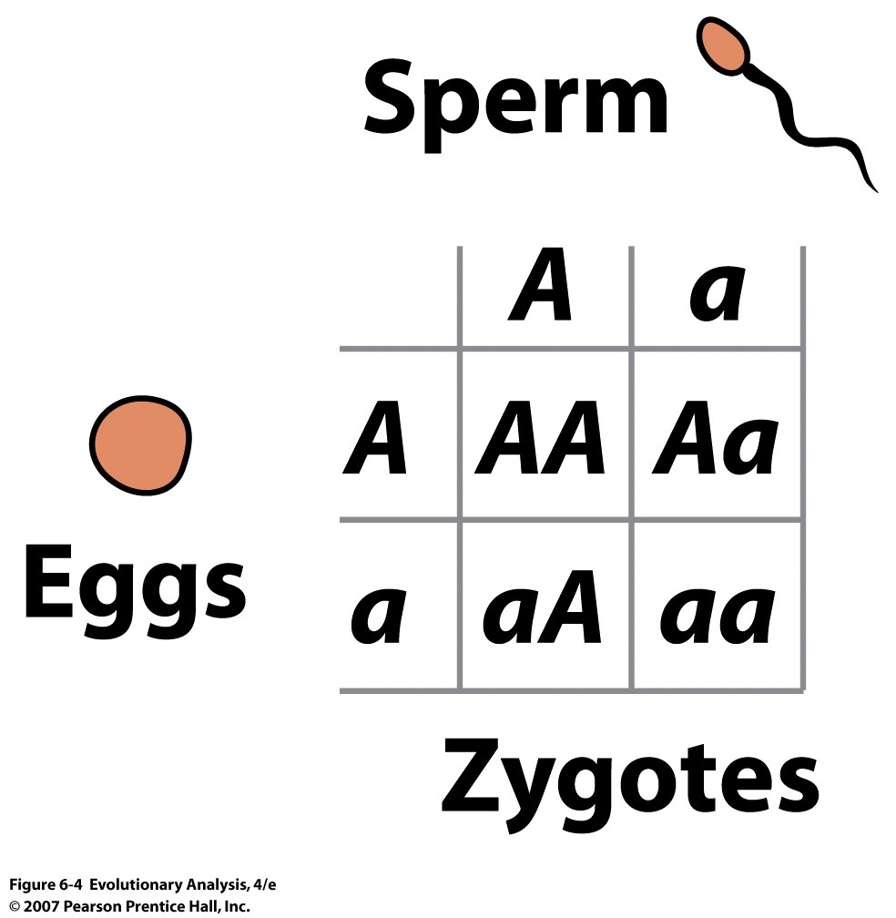
Punnett square for a cross between two heterozygotes
Notes:
Figure 6.4 Punnett square for a cross between two heterozygotes
This device makes accurate predictions about the genotype frequencies among the zygotes because the genotypes of the eggs and sperm are represented in the proportions in which the parents produce them.

Slide 7
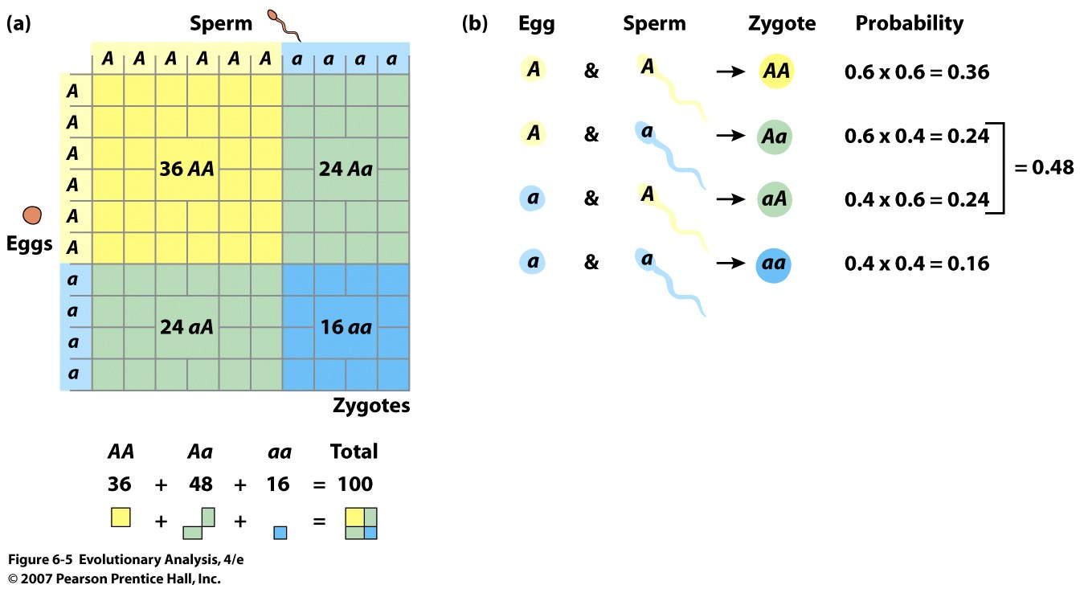
Haploid sperm and eggs fuse randomly with respect to genotype:
A = 0.6
a = 0.4
Notes:
Figure 6.5 When blind luck plays no role, random mating in the gene pool of our model mouse population produces zygotes with predictable genotype frequencies
(a) A Punnett square. The genotypes of the gametes are listed along the left and top edges of the box in proportions that reflect the frequencies of A and a eggs and sperm in the gene pool. The shaded areas inside the box represent the genotypes among 100 zygotes formed by random encounters between gametes in the gene pool. (b) We can also calculate genotype frequencies among the zygotes by multiplying allele frequencies.

Slide 8
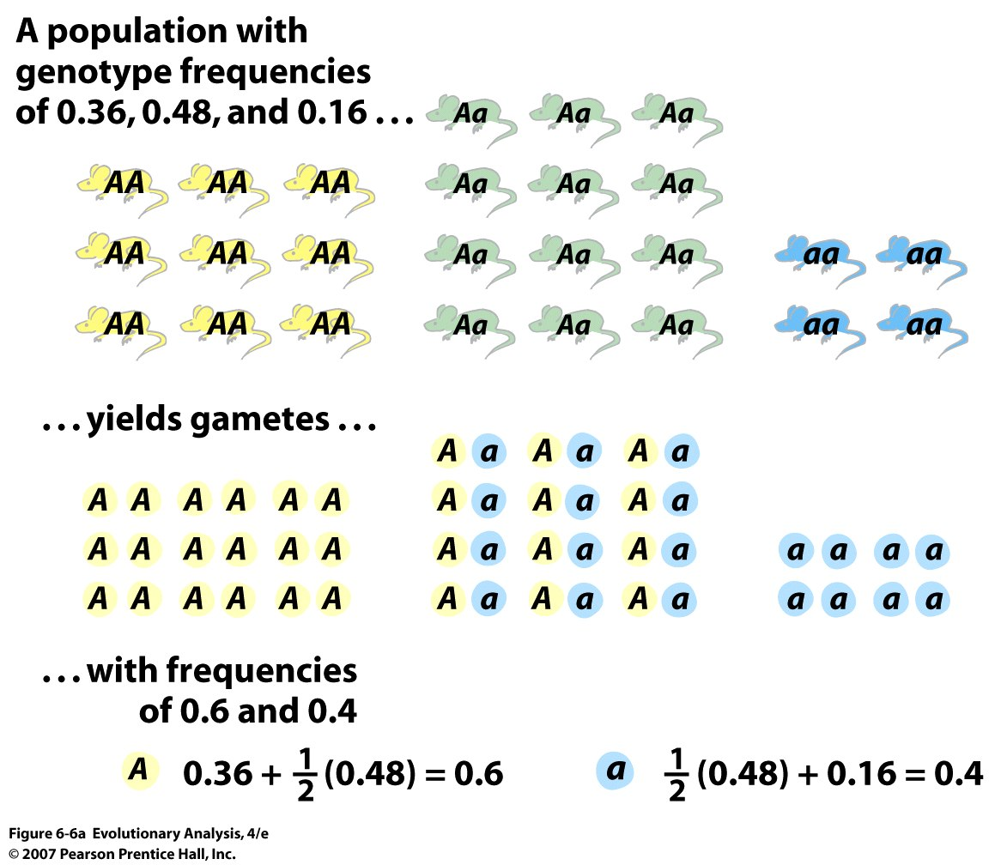
Population of
25 individuals
Or by copies (25 individuals)
Frequency of (A) = : 9x2 + 12 = 30/50 = 0.6
Notes:
Figure 6.6a When the adults in our model mouse population make gametes, they produce a gene pool in which the allele frequencies are identical to the ones we started with a generation ago
(a) Calculations using frequencies.

Slide 9
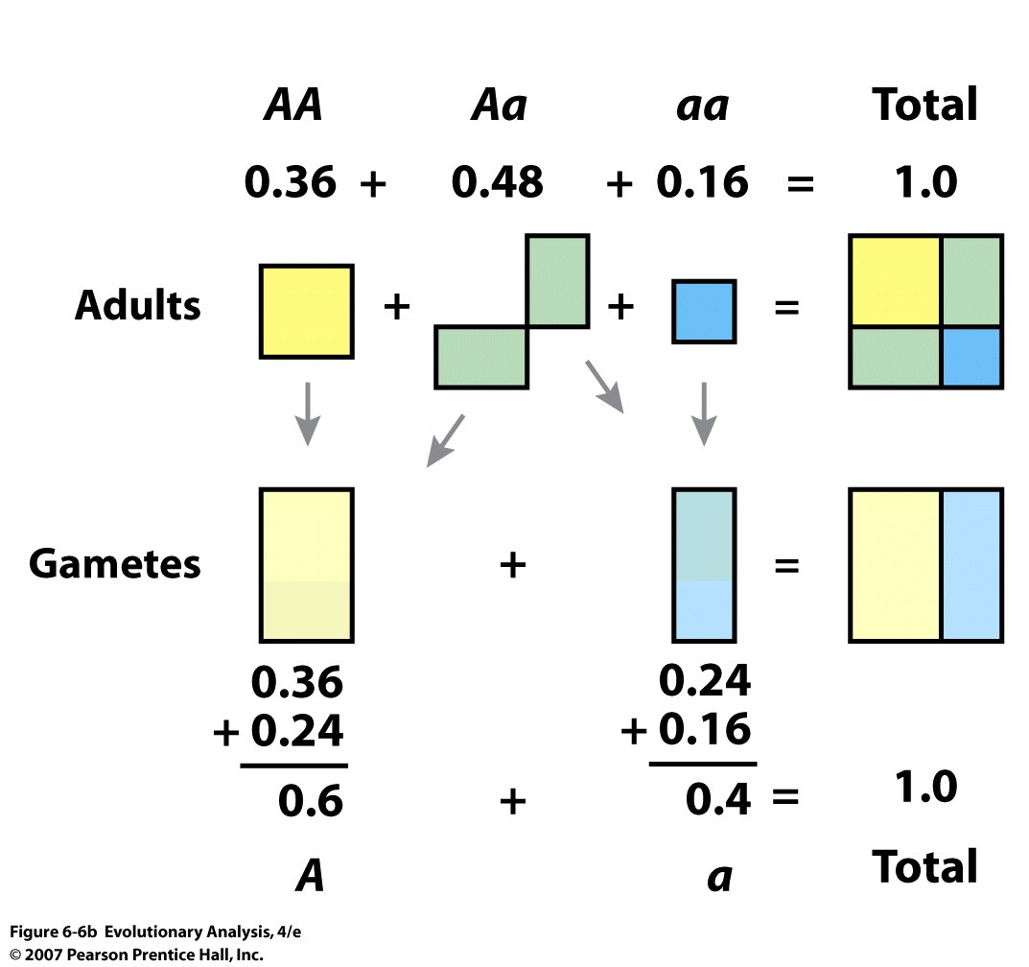
Notes:
Figure 6.6b When the adults in our model mouse population make gametes, they produce a gene pool in which the allele frequencies are identical to the ones we started with a generation ago
(b) A geometrical representation. The area of each box represents the frequency of an adult or gamete genotype. Note that half the gametes produced by Aa adults carry allele A, and half carry allele a.

Slide 10
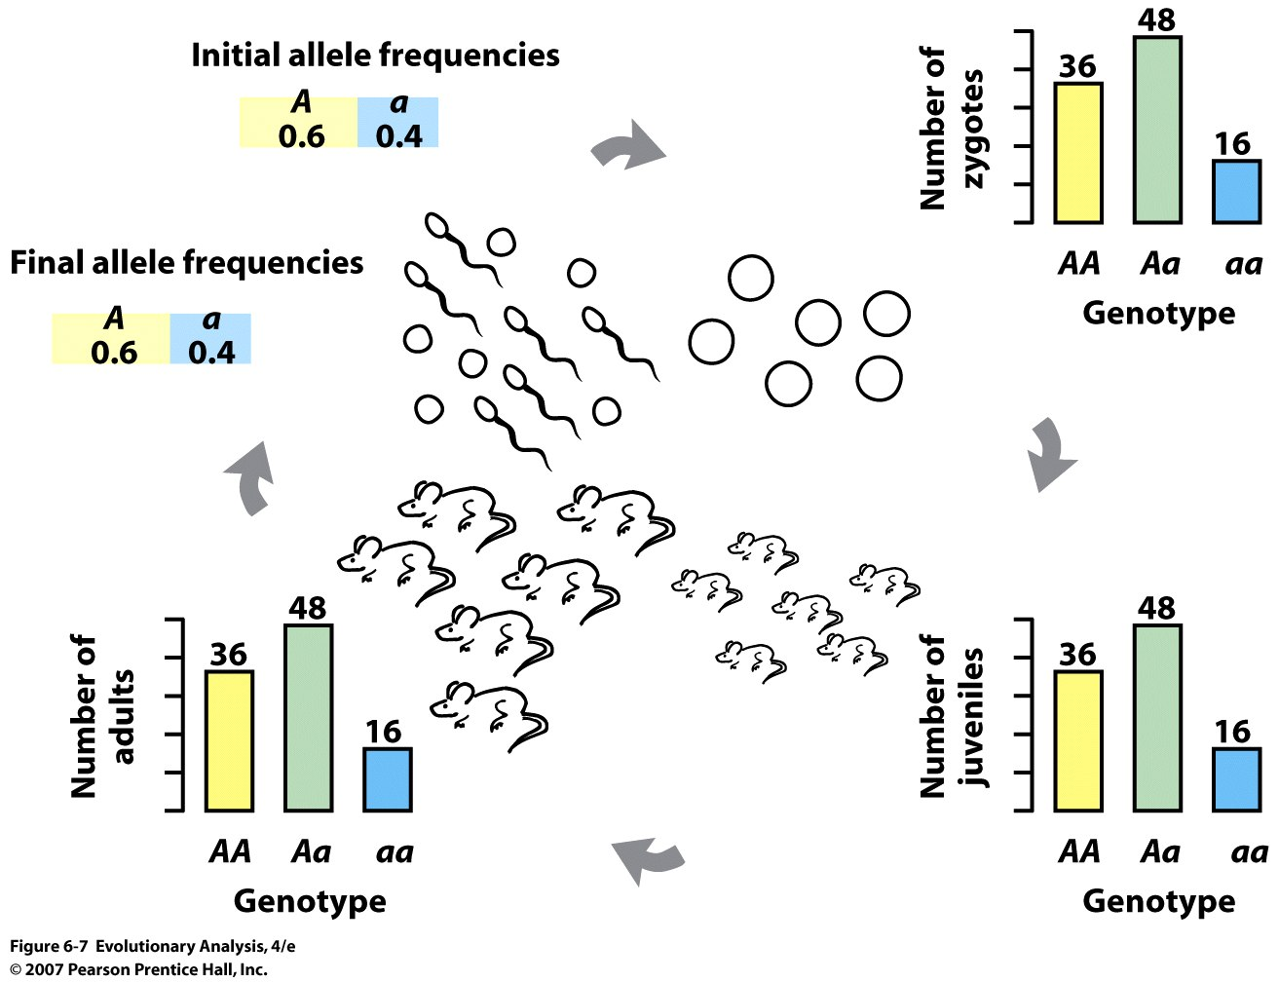
Notes:
Figure 6.7 When blind luck plays no role in our model population, the allele frequencies do not change from one generation to the next
We made the zygotes with the Punnett square in Figure 6.5, and assumed that all the zygotes survived.

Slide 11
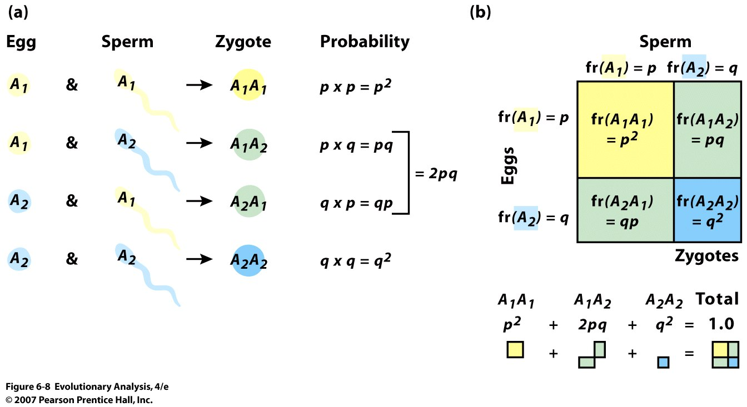
Sampling of haploid gametes represents binomial sampling:
(2 gametes/zygote)
Prob(choosing A1) = p
Prob(choosing A2) = q
Probability of various combinations of A1 and A2 = (p + q)²=
Notes:
Figure 6.8 The general case for random mating in the gene pool of our model mouse population
We can predict the genotype frequencies among the zygotes by multiplying the allele frequencies. (b) A Punnett square. The variables along the left and top edges of the box represent the frequencies of A and a eggs and sperm in the gene pool. The expressions inside the box represent the genotype frequencies among zygotes formed by random encounters between gametes in the gene pool.
Freqyenc if carriers = 2q/1= 2q

Slide 12
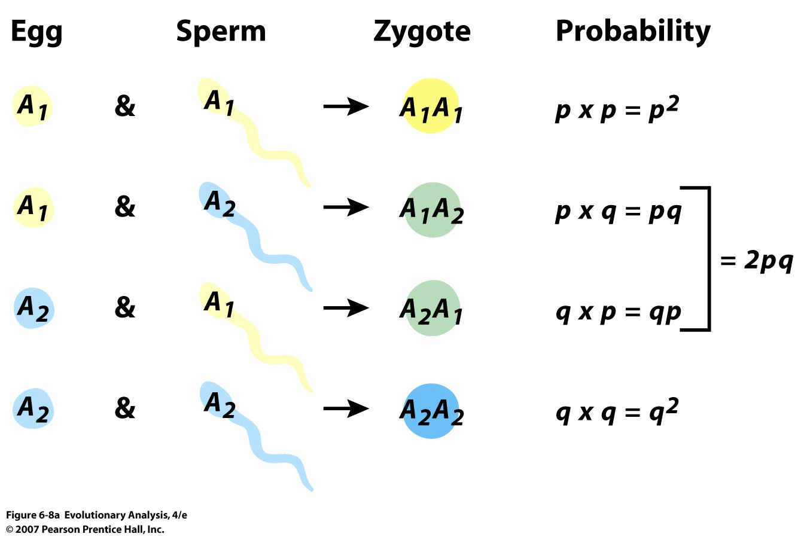
The general case for random mating in the gene pool of our model mouse population
(a) We can predict the genotype frequencies among the zygotes by multiplying the allele frequencies.
Notes:
Figure 6.8a The general case for random mating in the gene pool of our model mouse population
(a) We can predict the genotype frequencies among the zygotes by multiplying the allele frequencies.

Slide 13
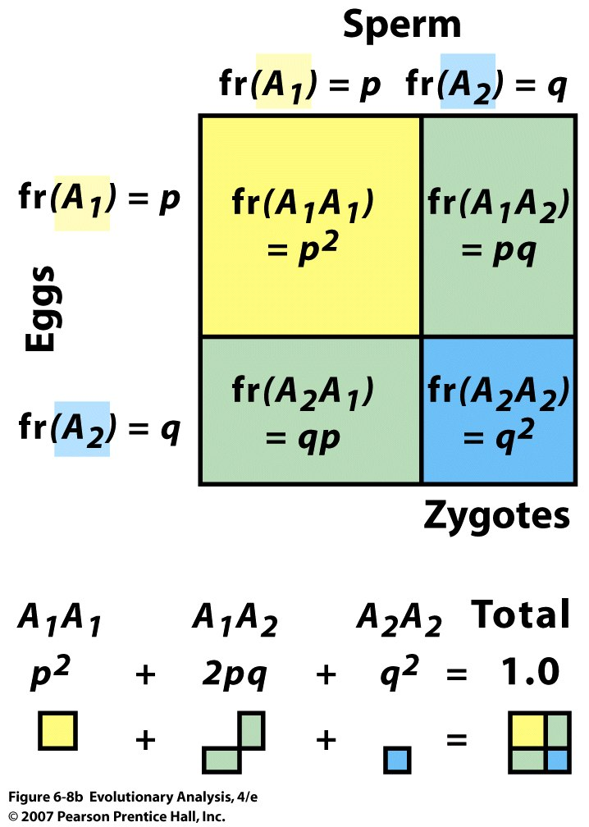
Notes:
Figure 6.8b The general case for random mating in the gene pool of our model mouse population
(b) A Punnett square. The variables along the left and top edges of the box represent the frequencies of A and a eggs and sperm in the gene pool. The expressions inside the box represent the genotype frequencies among zygotes formed by random encounters between gametes in the gene pool.

Slide 14
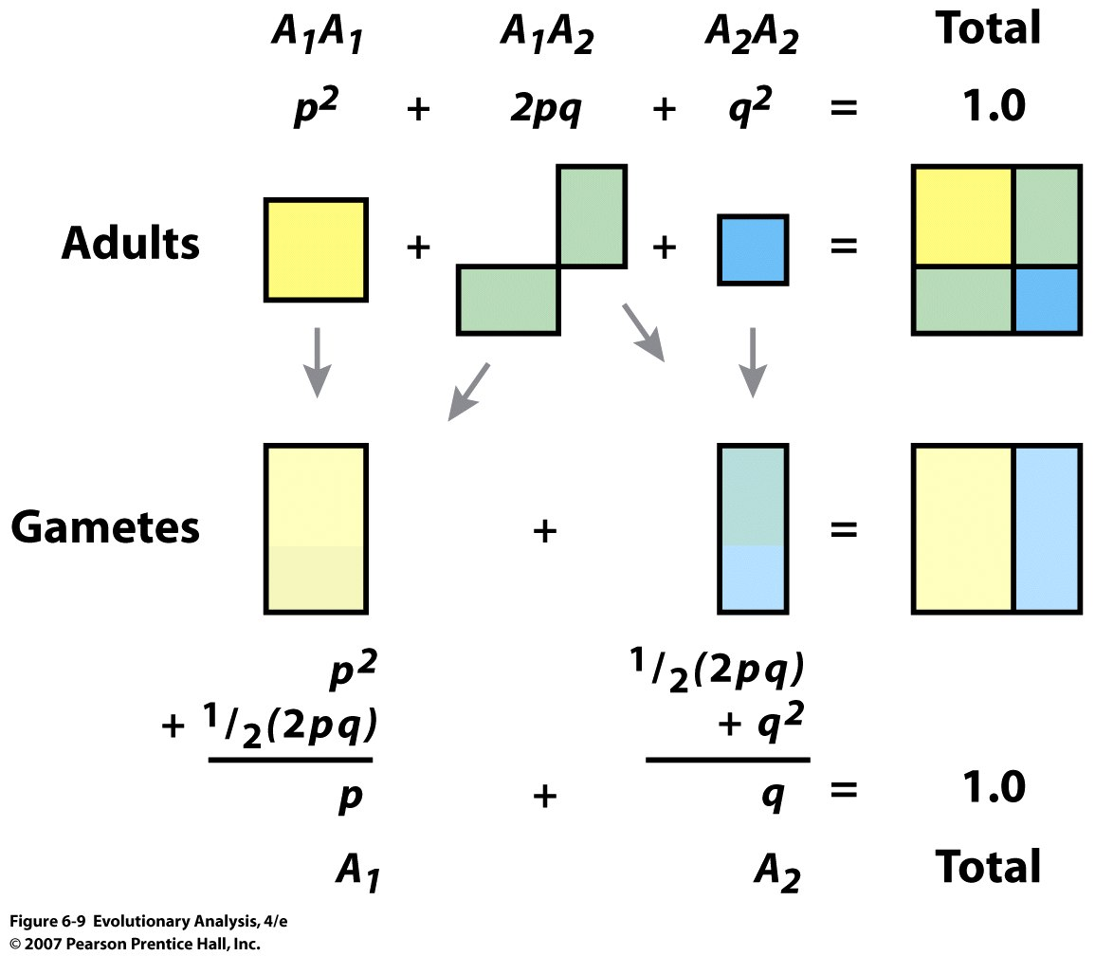
p2 + p(1-p) = p
Notes:
Figure 6.9 A geometrical representation of the general case for the allele frequencies produced when the adults in our model population make gametes
The area of each box represents the frequency of an adult or gamete genotype.

Slide 15
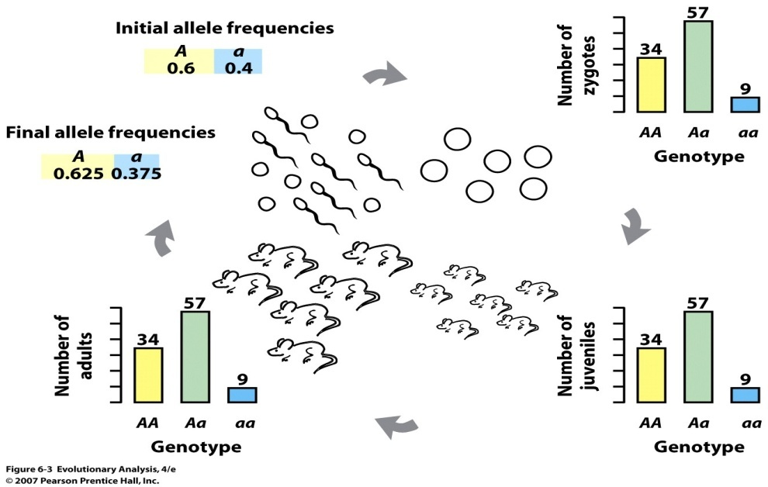
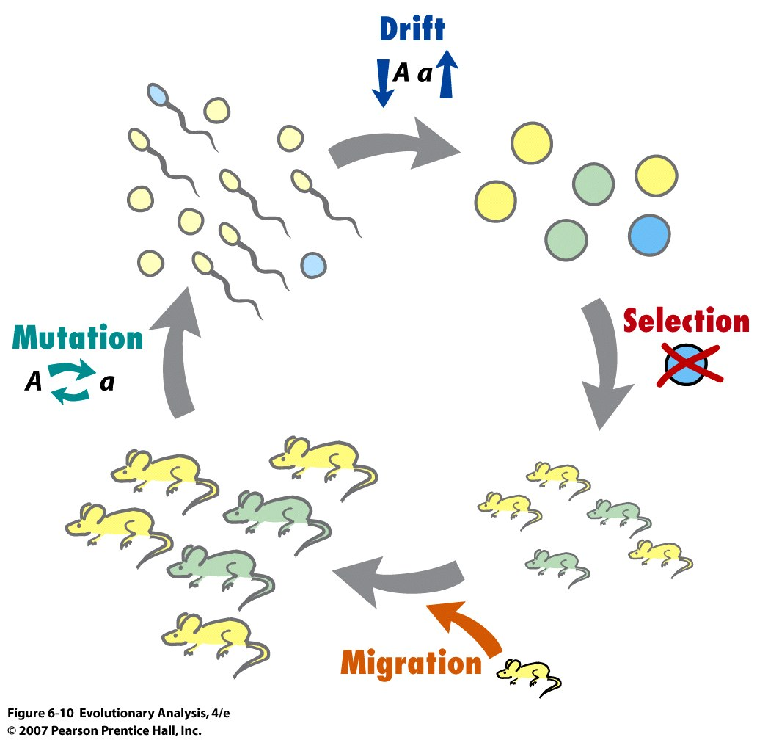
III. 4 modes of Evolution
Notes:
Figure 6.10 Summary of the mechanisms of evolution
Selection, migration, mutation, and genetic drift are the four processes that can cause allele frequencies to change from one generation to the next. Selection occurs when individuals with different genotypes survive or make gametes at different rates. Migration occurs when individuals move into or out of the population. Mutation occurs when mistakes during meiosis turn copies of one allele into copies of another. Genetic drift occurs when blind chance allows gametes with some genotypes to participate in more fertilizations than gametes with other genotypes.

Slide 16
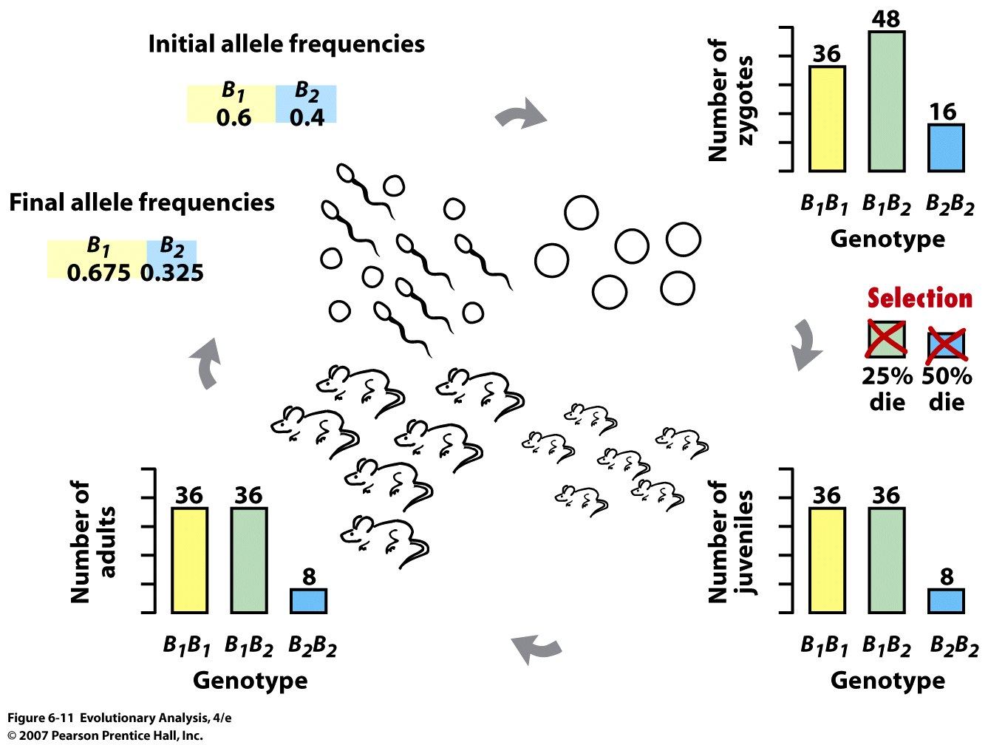
IV. Natural Selection
Notes:
Figure 6.11 Selection can cause allele frequencies to change across generations
This figure follows our model mouse population from one generation's gene pool to the next generation's gene pool. The bar graphs show the number of individuals of each genotype in the population at any given time. Selection, in the form of differences in survival among juveniles, causes the frequency of allele B₁ to increase.

Slide 17
Notes:
go through life cycle, note that the new q = , in pa
W = weight

Slide 18
Fitness- the RELATIVE ability of an individual to survive
and reproduce compared to other individuals
in the SAME population
abbreviated as w
Selection- differences in survivorship and reproduction
among individuals associated with the
expression of specific values of traits or
combinations of traits
natural selection- selection exerted by the natural
environment, target = fitness
artificial selection- selection exerted by humans
target = yield
selection coefficient is abbreviated as s
w = 1-s
Notes:
demonstrate how to calculate s and fitness, draw table on next slide on board and show fitness

Slide 19
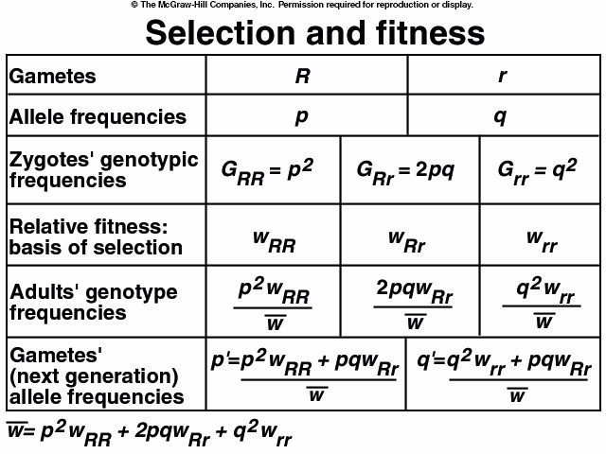
Notes:
in parallel do haploid

Slide 20
q’ – q = change in q from ONE generation to the Next
(q²)w_{rr} + (pq)w_{Rr -q}
=
change(q) = pq[ q(w_{rr} – w_{Rr}) + p(w_{Rr} – w_{RR})]
What are the components of the above equation?
explore with selection against homozygote
(haploid, diploid, tetraploid)
w
W
Notes:
show on board. numerator,- spq2, and when s = 1 ; -pq2, focus on frequency, s and mean fitness

Slide 21
change(q) = pq[ q(w_{rr} – w_{Rr}) + p(w_{Rr} – w_{RR})]
_________________________
W
For selection acting only against recessive homozygote:
q - q’ = -spq²
w

Slide 22
Haploid Selection:
qWr – q ; numerator = qWr - q(pWR + qWr)
(pWR + qWr)
q(1-s) – q(p(1) + q(1-s))
q(1-s) – q(p + q – qs)
q(1-s) – q(1-qs)
q –qs – q + qqs
-qs + qqs
-qs(1-q)
-qps = -spq/ mean fitness

Slide 23
How quickly can selection change allele frequencies??
theory:
for selection against a lethal recessive in the homozygote
condition
say RR Rr rr and rr is lethal (dies before reproducing)
t = 1/q_{t} - 1/q_{o}
t is number of generations
Notes:
Go from 0.9 to o.1. 0.1 to 0.01

Slide 24
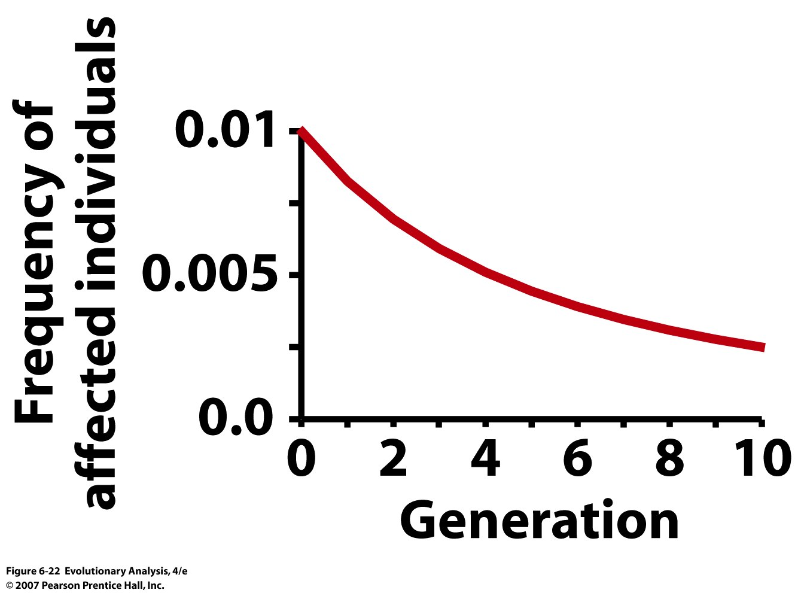
Predicted change in the frequency of homozygotes for a putative allele
for feeblemindedness under a eugenic sterilization program that prevents
homozygous recessive individuals from reproducing.
Notes:
Figure 6.22 Predicted change in the frequency of homozygotes for a putative allele for feeblemindedness under a eugenic sterilization program that prevents homozygous recessive individuals from reproducing.

Slide 25
Persistent selection can change allele frequencies: Heterozygote has
intermediate fitness
Notes:
Figure 6.12 Persistent selection can produce substantial changes in allele frequencies over time
Each curve shows the change in allele frequency over time under a particular selection intensity.

Slide 26
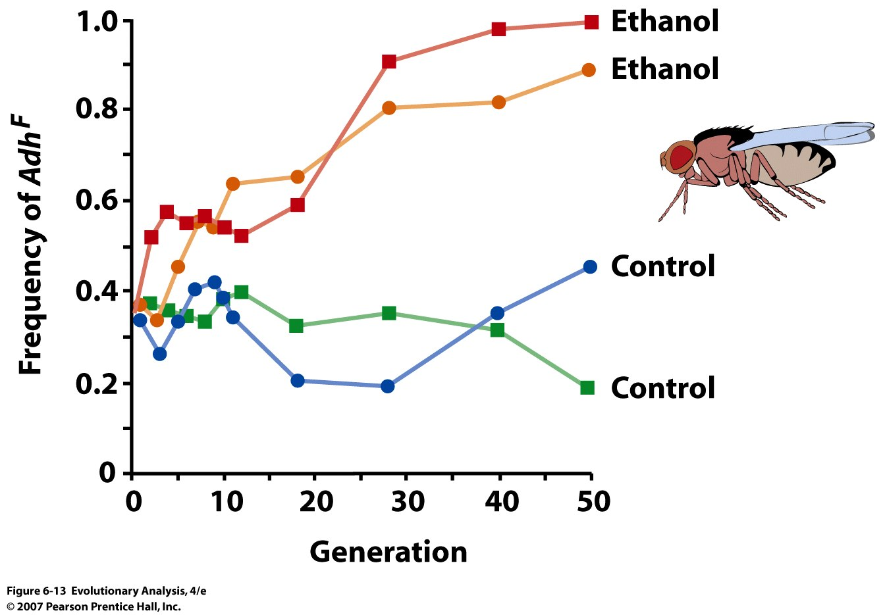
V. Examples
Notes:
Figure 6.13 Frequencies of the Adh^{F} allele in four populations of fruit flies over 50 generations
The blue and green dots and lines represent control populations living on normal food; the red and orange dots and lines represent experimental populations living on food spiked with ethanol. From Cavener and Clegg (1981).

Slide 27
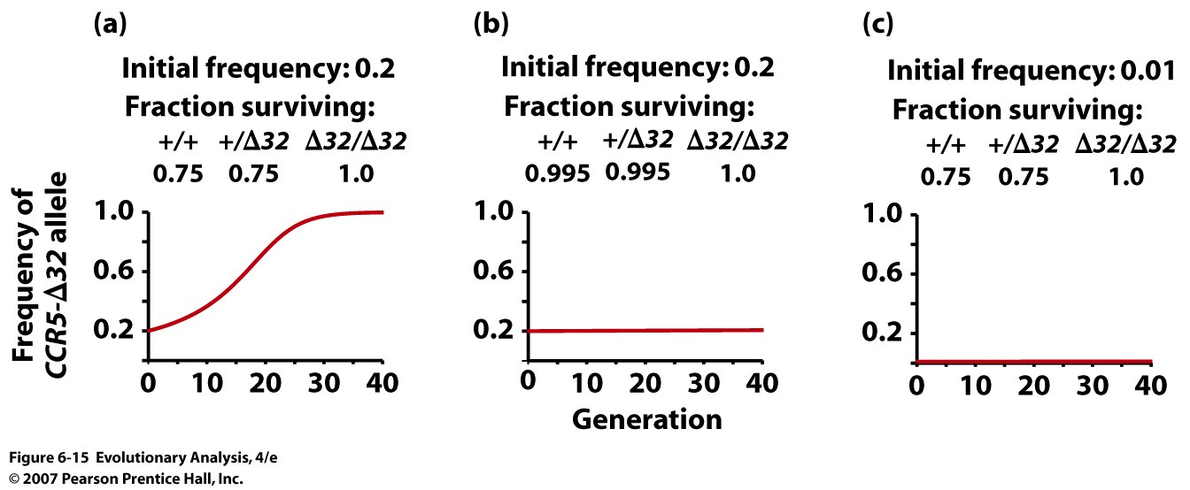
Natural Selection and HIV
Notes:
Figure 6.15 Predicted change in allele frequencies at the CCR5 locus due to the AIDS epidemic under three different scenarios
(a) When the initial frequency of the CCR5-Δ32 allele is high and a large fraction of the population becomes infected with HIV, the allele frequencies can change rapidly. However, no real population combines these characteristics. (b) In European populations allele frequencies are high, but only a small fraction of individuals become infected. (c) In parts of Africa there are high infection rates, but allele frequencies are low.

Slide 28
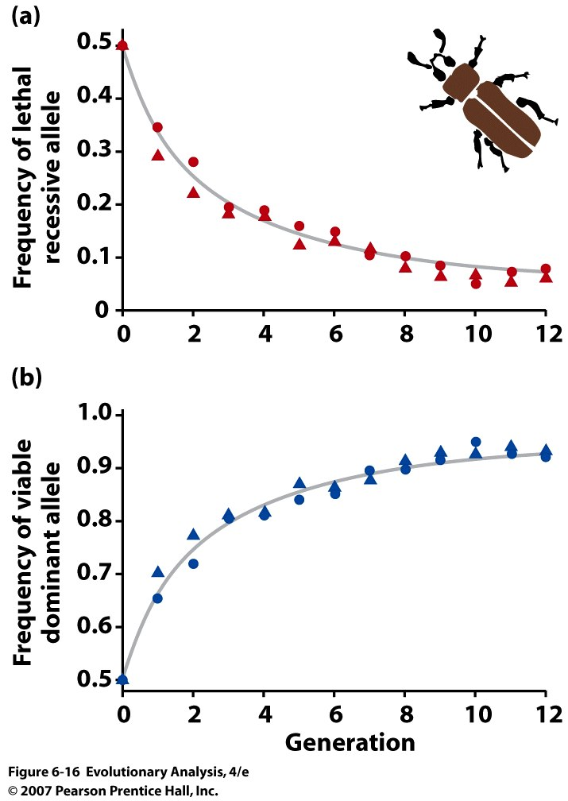
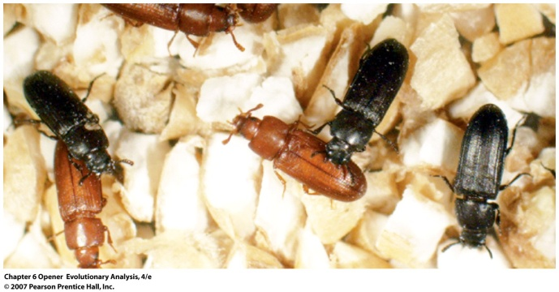
Evolution in laboratory populations of flour beetles
Notes:
Figure 6.16 Evolution in laboratory populations of flour beetles
(a) The decline in frequency of a lethal recessive allele (red symbols) matches the theoretical prediction (gray curve) almost exactly. As the allele becomes rare, the rate of evolution slows dramatically. (b) This graph plots the increase in frequency of the corresponding dominant allele. Redrawn from Dawson (1970).

Slide 29
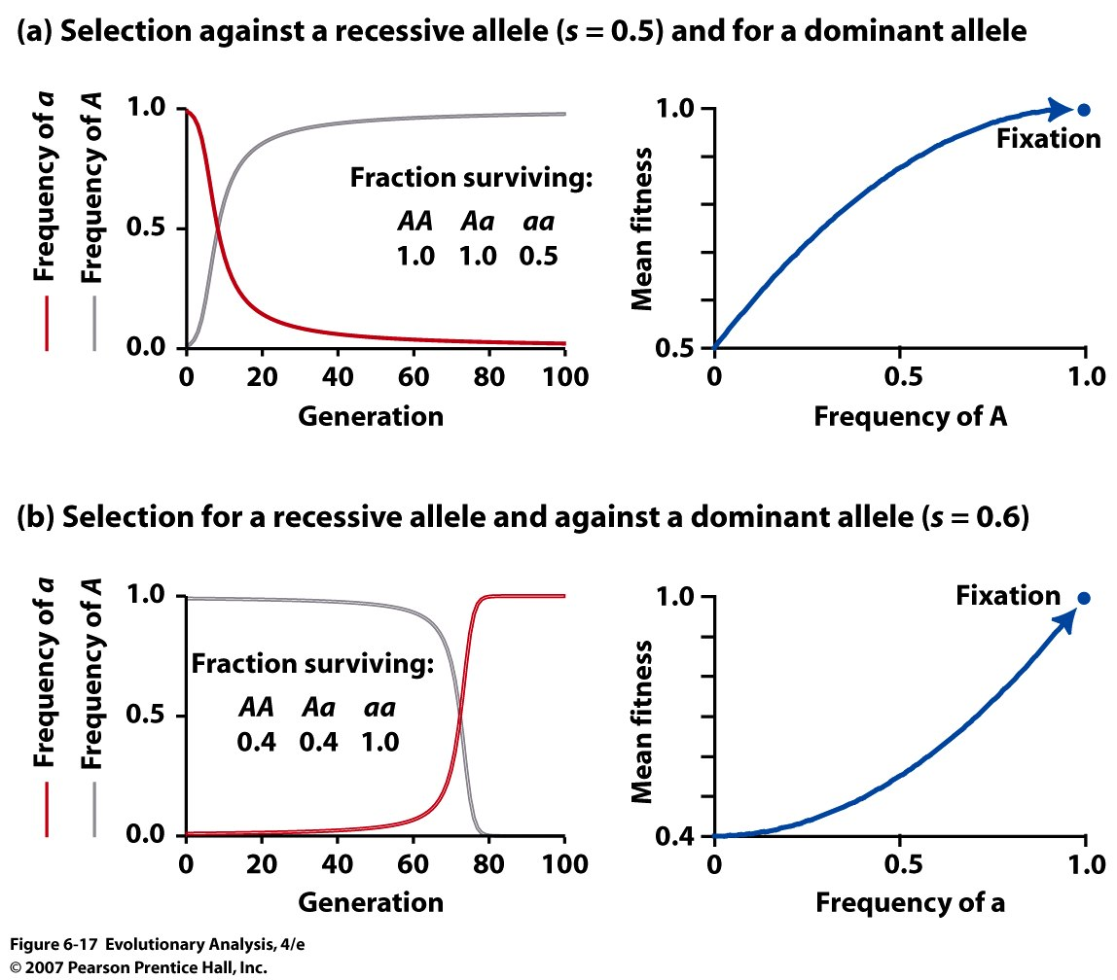
Notes:
Figure 6.17 Evolution in model populations under selection on recessive and dominant alleles
Graphs on the left show changes in allele frequencies over time. Graphs on the right show adaptive landscapes: Changes in population mean fitness as a function of allele frequencies.

Slide 30
VI. Different types of selection

Slide 31
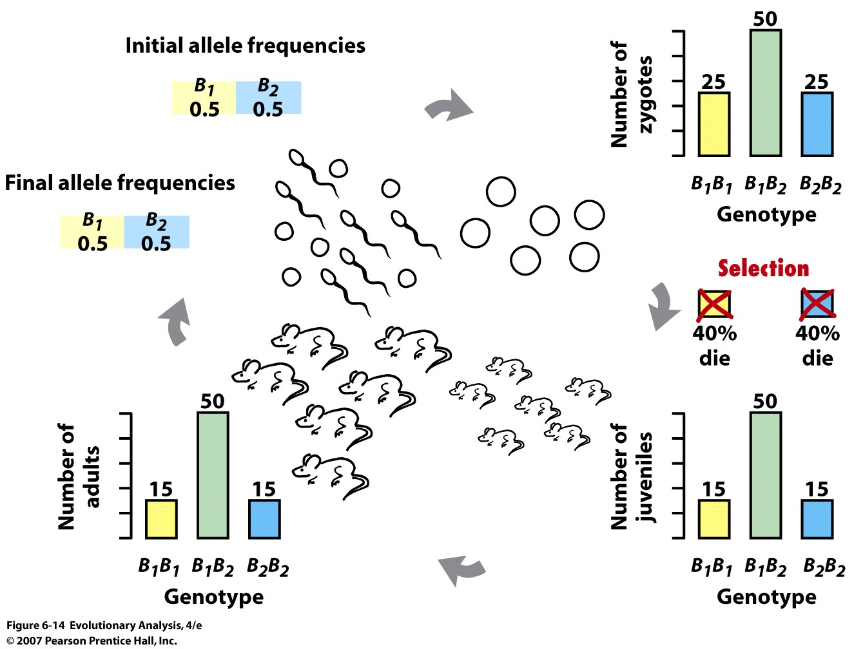
Selection can change genotype frequencies so that they cannot be
calculated by multiplying the allele frequencies
Notes:
Figure 6.14 Selection can change genotype frequencies so that they cannot be calculated by multiplying the allele frequencies
When 40% of the homozygotes in this population die, the allele frequencies do not change. But among the survivors, there are more heterozygotes than predicted under Hardy-Weinberg equilibrium.

Slide 32
change(q) = pq[ q(w_{rr} – w_{Rr}) + p(w_{Rr} – w_{RR})]
_________________________
-
W
with selection against either homozygote, heterozygote
is favored wrr = 1-s2, wRR = 1-s1, wRr = 1: set above to 0
substitute 1-s1 and 1-s2: -qs2 + ps1 = 0
ps1 – qs2 = 0; (1-q)s1 – qs2 = 0; s1 –s1q –s2q = 0
q(s1 +s2) = s1
q at equilibrium = s1/(s1 + s2)
with Rr favored, always find R, r
alleles in population
Notes:
should lead to maintenance of alleles, substitute 1-s1 and 1-s2,
-qs2 + ps1 = 0
ps1 – qs2 = 0
1-q)s1 – qs2 = 0
s1 –s1q –s2q = 0
q(s1 +s2) = s1
qequil. = s1/ (s1 + s2)

Slide 33
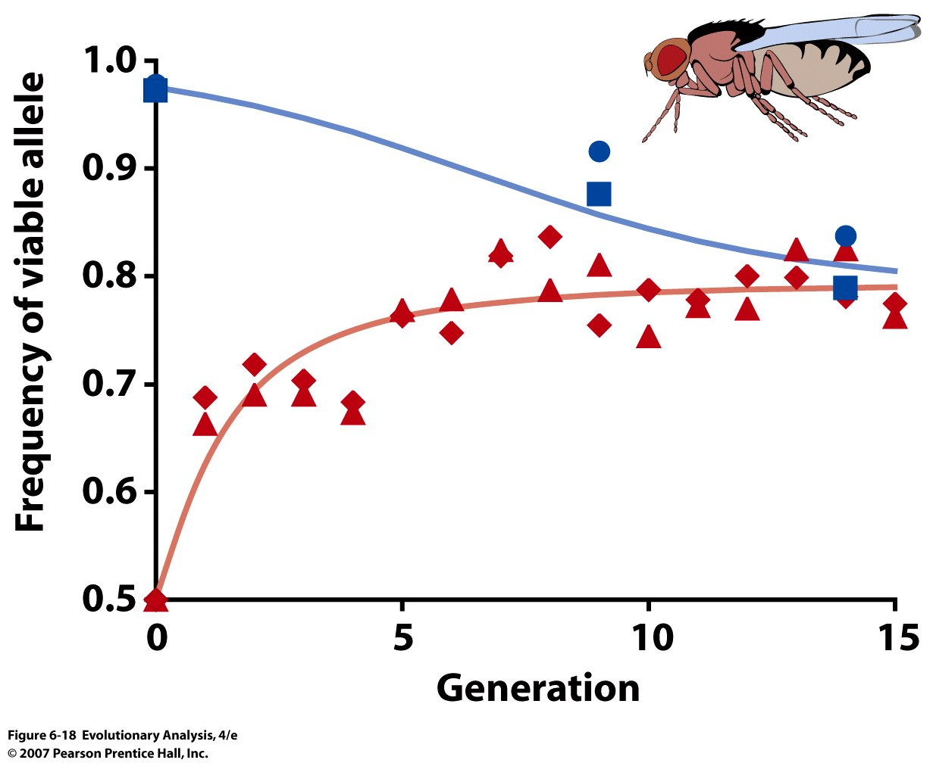
Selection favoring the Heterozygote = Overdominance
2 populations founded with allele freq = 0.5
Maintains genetic variation
Notes:
Figure 6.18 Evolution in four laboratory populations of fruit flies
In homozygous state, one allele is viable and the other allele is lethal. Nonetheless, the populations that started with a frequency of 0.5 for both alleles (red) evolved toward an equilibrium in which both alleles are maintained. The likely explanation is that heterozygotes enjoy superior fitness to either homozygote. The blue populations represent a test of this hypothesis. The data (circles and squares) match the theoretical prediction (line) closely. Drawn from data presented in Mukai and Burdick (1959).

Slide 34
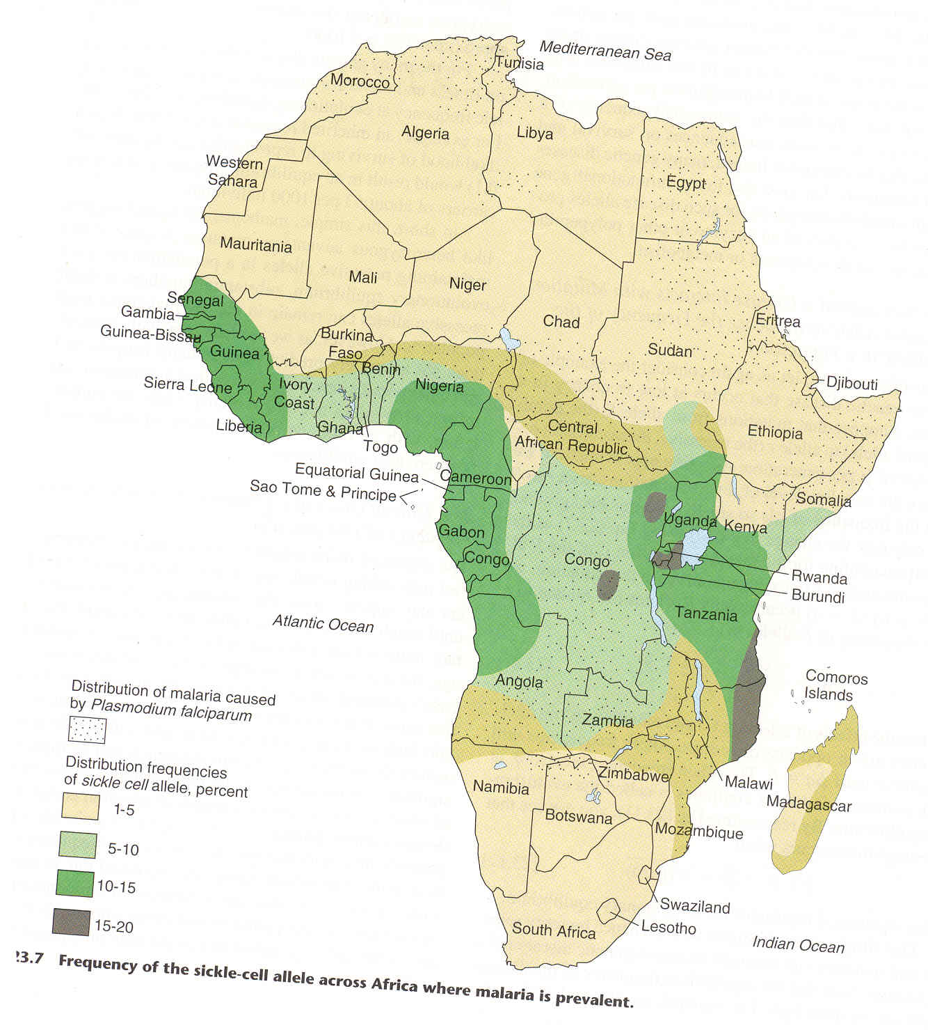
Sickle Cell Anemia
and the evolution
of resistance to
malaria:
The case for
Heterozygote
Advantage

Slide 35
APPLICATION:
Can we calculate the selection coefficients on alleles
associated with Sickle Cell??
Sickle Cell Anemia:
freq of s allele (q) = 0.17
0.17 = s1/(s1 + s2)
if s2 = 1, then s1 = 0.2
then the advantage of Ss heterozygotes is 1/0.8 = 1.25
over the SS homozygote
Notes:
we will assume s2= 1, what is advantage of Ss, fertility advantage

Slide 36
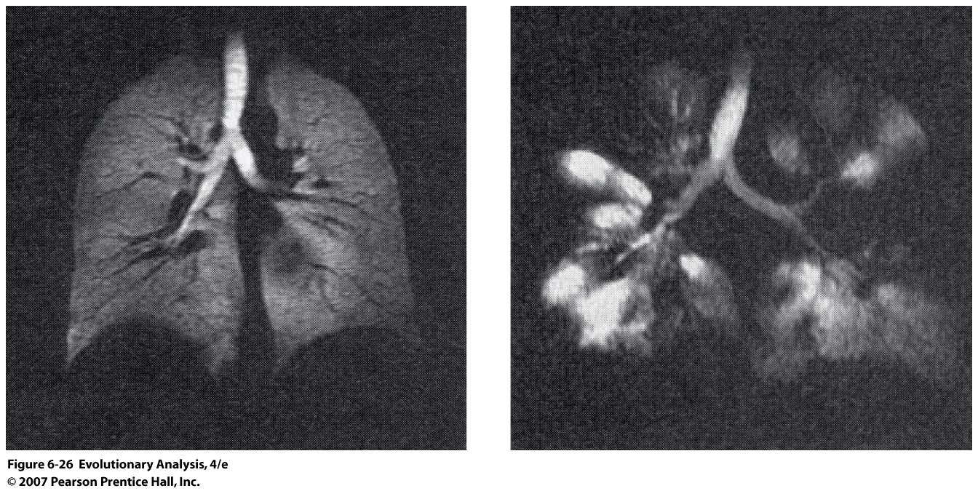
Is cystic fibrosis an example of heterozygote superiority??
http://en.wikipedia.org/wiki/Typhoid_fever
Notes:
Figure 6.26 A normal lung (left) versus a lung ravaged by the bacterial infections that accompany cystic fibrosis (right).

Slide 37
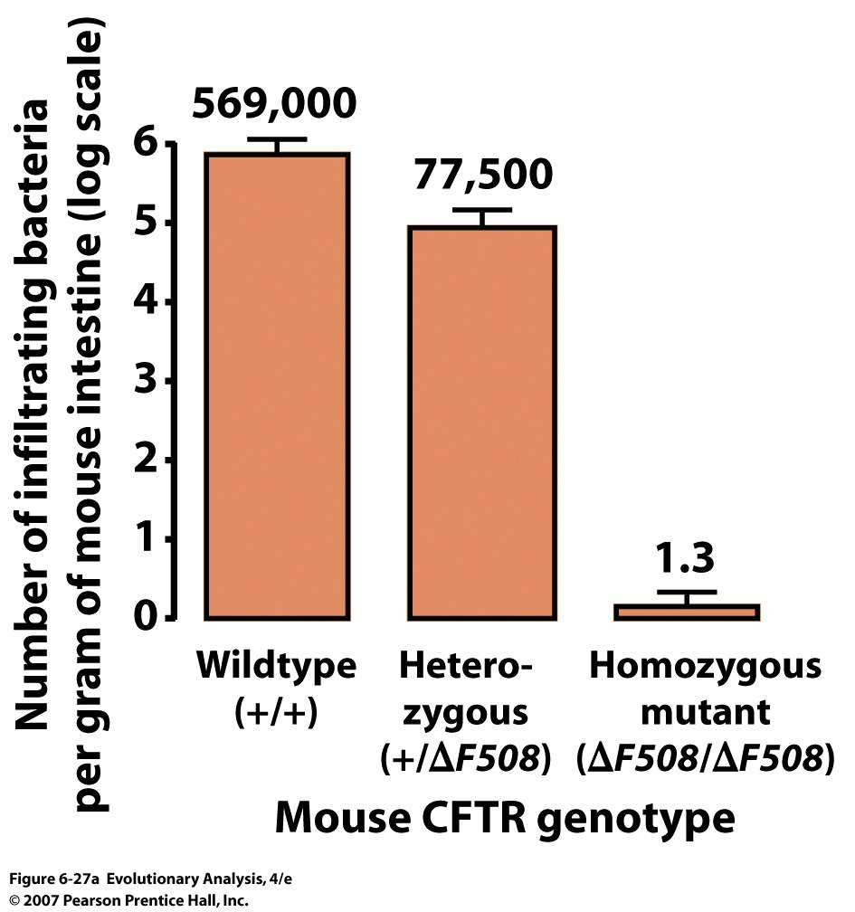
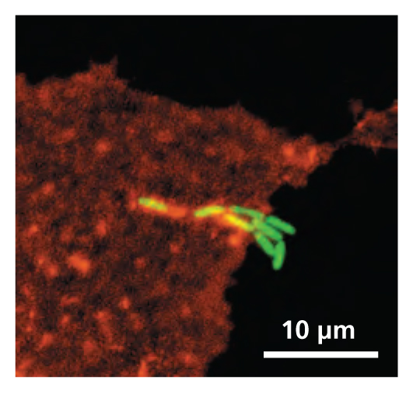
Bacteria are Typhoid Bacteria
Notes:
Figure 6.27a Heterozygotes for the ΔF508 allele are resistant to typhoid fever
Cultured mouse cells heterozygous for cystic fibrosis show substantial resistance to infiltration by the bacteria that cause typhoid fever. Cells homozygous for ΔF508, the most common human disease allele, are almost totally resistant. From Pier et al. (1998).
yphoid fever, also known as typhoid,^{[1]} is a common worldwide illness, transmitted by the ingestion of food or water contaminated with the feces of an infected person, which contain the bacterium Salmonella typhi.^{[2][3]} The bacteria then perforate through the intestinal wall and are phagocytosed by macrophages. The organism is a Gram-negative short bacillus that is motile due to its peritrichous flagella. The bacterium grows best at 37 °C/99 °F – human body temperature.
This fever received various names, such as gastric fever, abdominal typhus, infantile remittant fever, slow fever, nervous fever, pythogenic fever, etc. The name of " typhoid " was given by Louis in 1829, as a derivative from typhus.
The impact of this disease falls sharply with the application of modern sanitation techniques

Slide 38
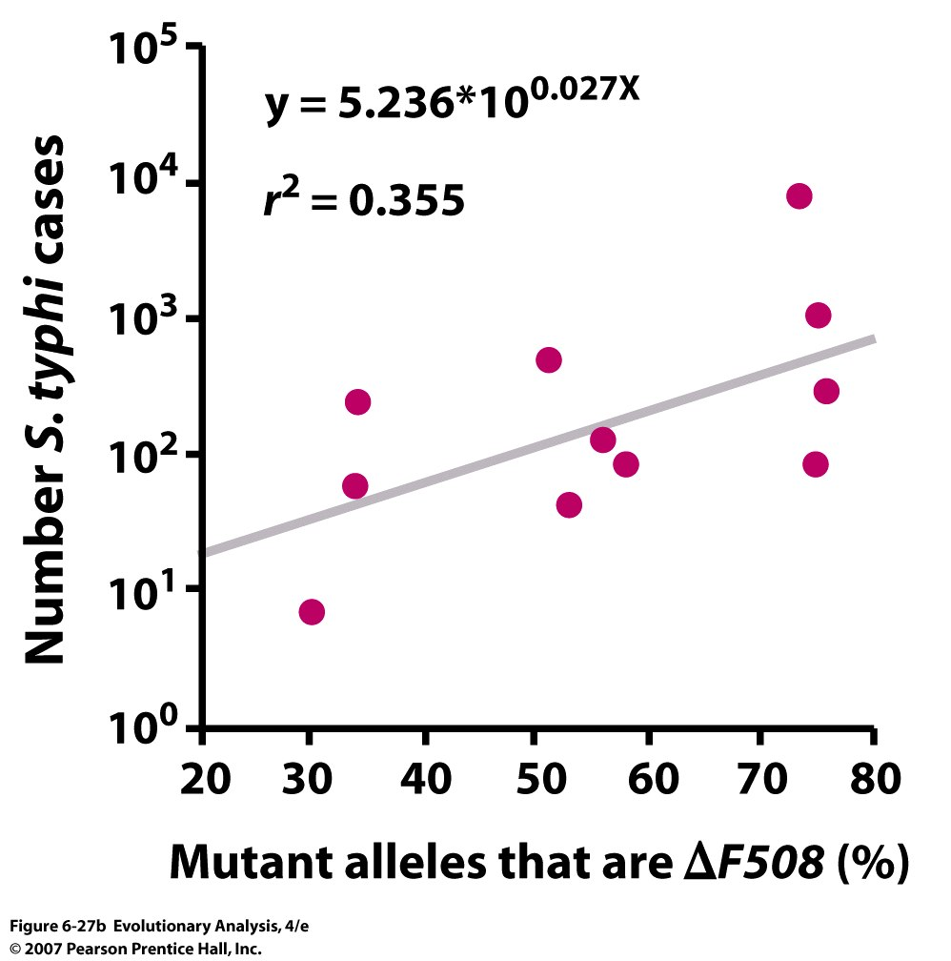
Notes:
Figure 6.27b Heterozygotes for the ΔF508 allele are resistant to typhoid fever
(b) Data from 11 European countries suggest that S. typhi selects for carriers of the ΔF508 allele. The frequency of the allele, among cystic fibrosis mutations, in the generation following a typhoid fever outbreak increases with the severity of the outbreak. From Lyczak et al. (2002).

Slide 39
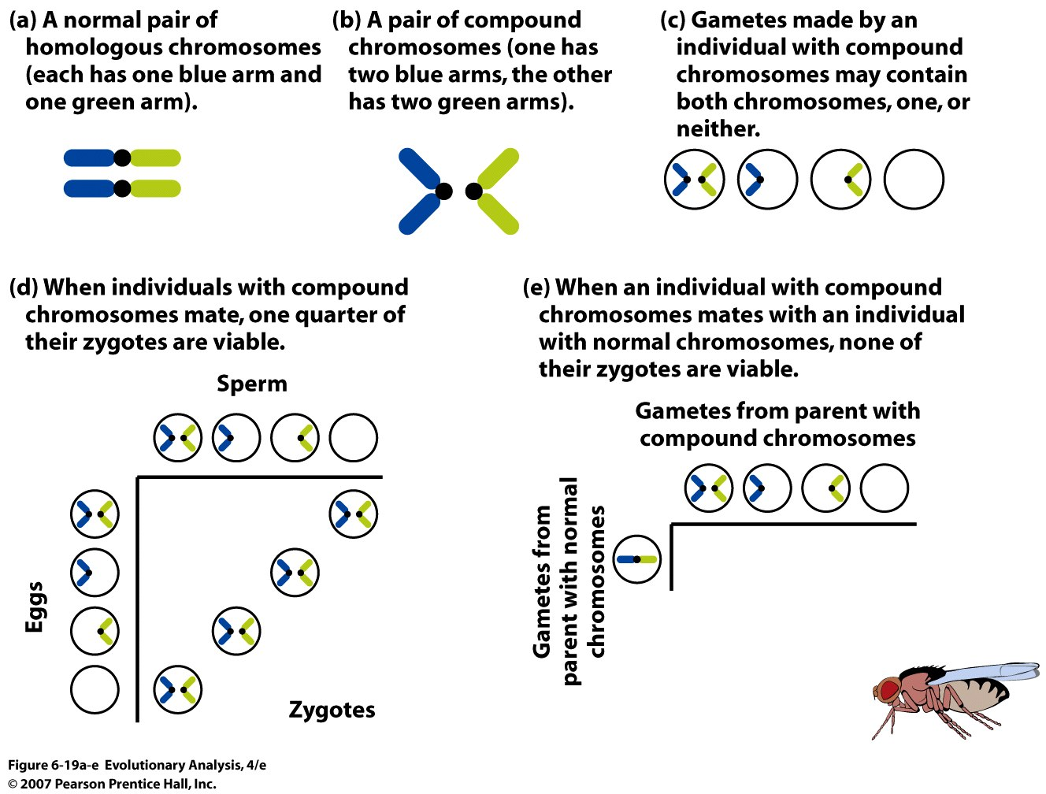
Selection acting against the Heterozygote= Underdominance
Analogous to speciation?
Notes:
Figure 6.19a-e An experiment designed to show how populations evolve when heterozygotes have lower fitness than either homozygote
(a-e) The experimental design makes clever use of compound chromosomes.

Slide 40
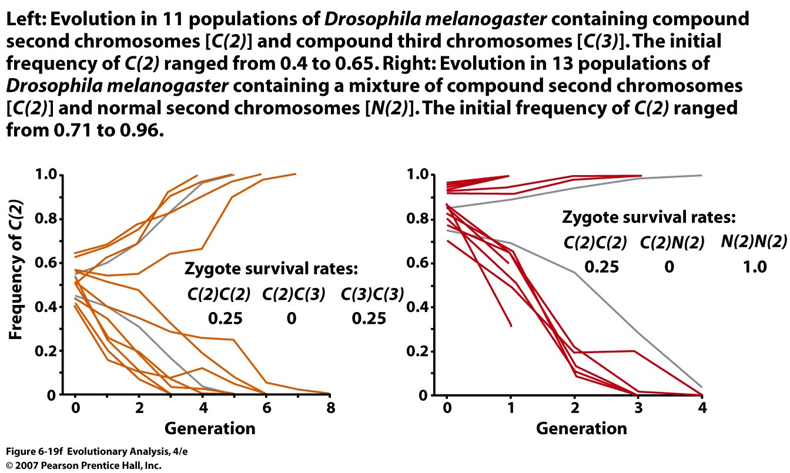
But many examples of hybrid inviability in plants and animals
consistent with underdominance but with different consequences
Notes:
Figure 6.19f An experiment designed to show how populations evolve when heterozygotes have lower fitness than either homozygote
(f) The data (orange and red) match the theoretical predictions (gray). Redrawn with permission from Foster et al. (1972).

Slide 41
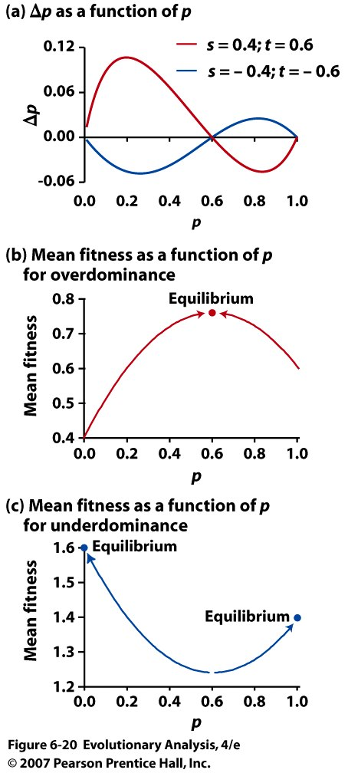
Summary of
Overdominance
And
Underdominance
Notes:
Figure 6.20 A graphical analysis of stable and unstable equilibria at loci with overdominance and underdominance
(a) A plot of Δp as a function of p. (b) and (c) Adaptive landscapes.

Slide 42
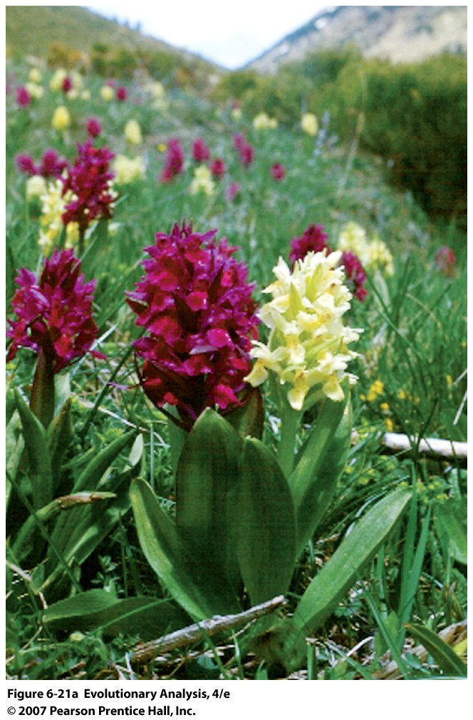
Frequency-dependent selection in Elderflower orchids
Notes:
Figure 6.21a Frequency-dependent selection in Elderflower orchids
(a) A mixed population. Some plants have yellow flowers, others have purple flowers.

Slide 43
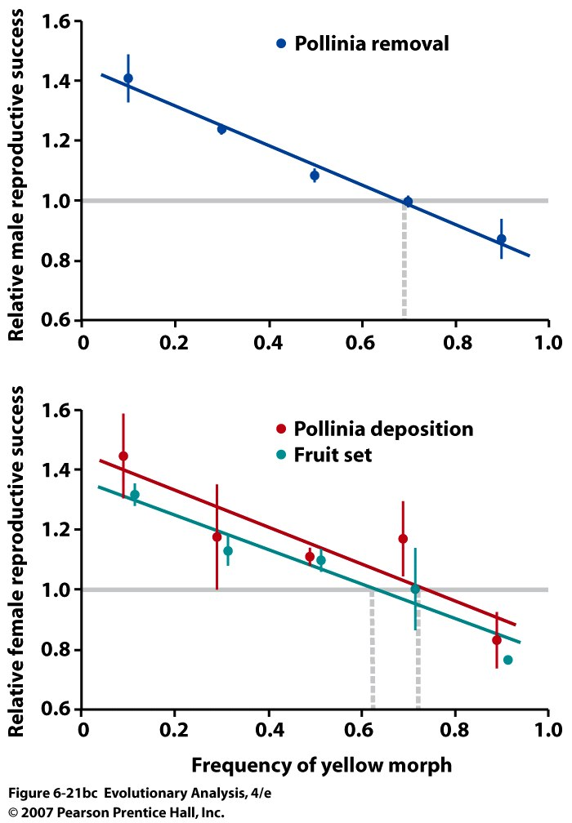
Notes:
Figure 6.21bc Frequency-dependent selection in Elderflower orchids
(b) Through male function, yellow flowers have higher fitness than purple flowers when yellow is rare, but lower fitness than purple flowers when yellow is common. (c) Through female function, yellow flowers have higher fitness than purple flowers when yellow is rare, but lower fitness than purple flowers when yellow is common. The dashed vertical lines show the predicted frequency of yellow flowers, which matches the frequency in natural populations. From Gigord et al. (2001).

Slide 44
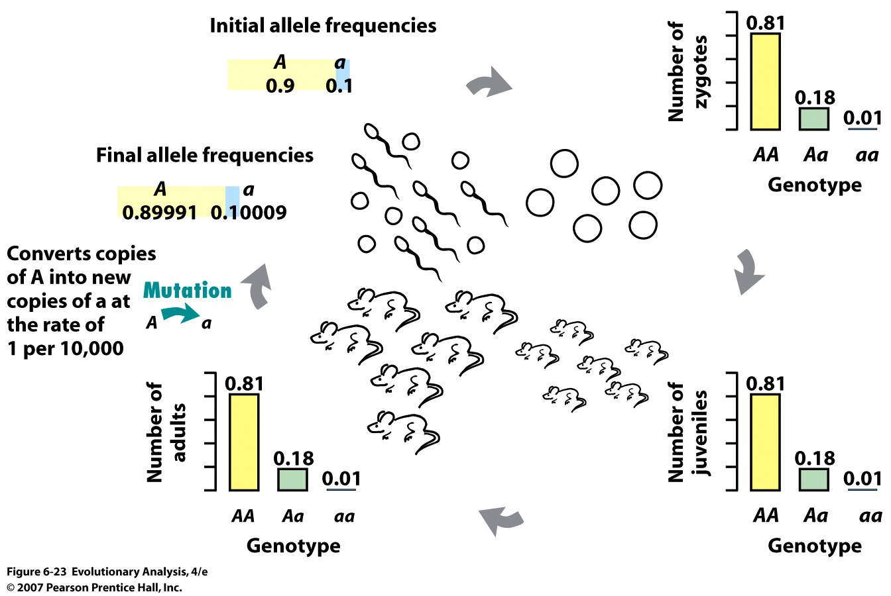
VII. Mutation and Selection
Notes:
Figure 6.23 Mutation is a weak mechanism of evolution
In a single generation in our model population, mutation produces virtually no change in allele and genotype frequencies.

Slide 45
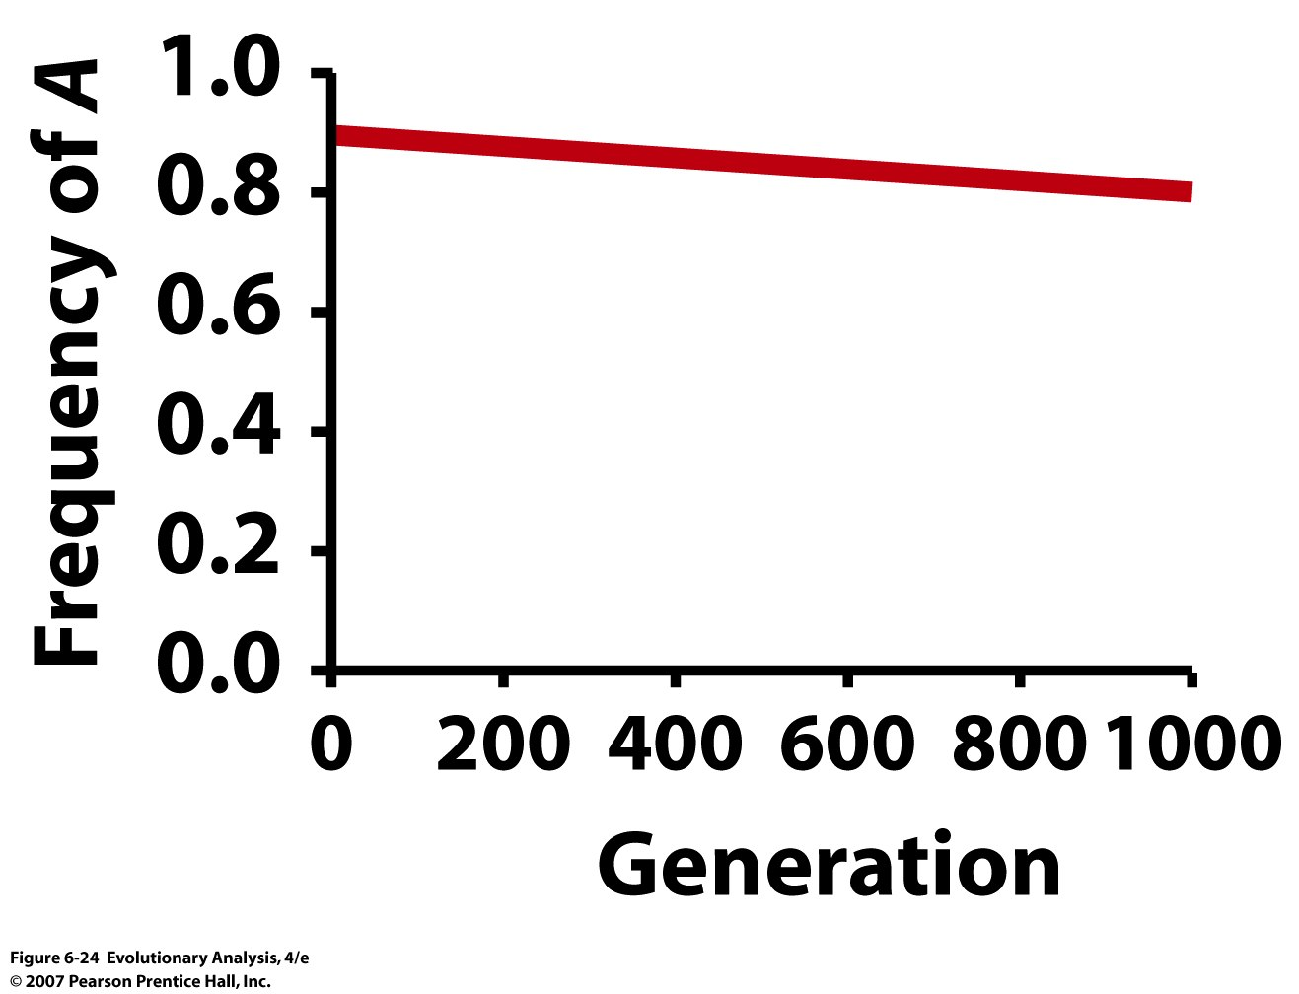
Notes:
Figure 6.24 Over very long periods of time, mutation can eventually produce appreciable changes in allele frequency.

Slide 46
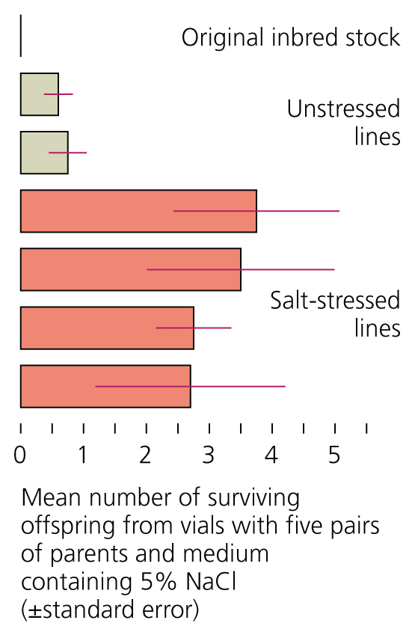
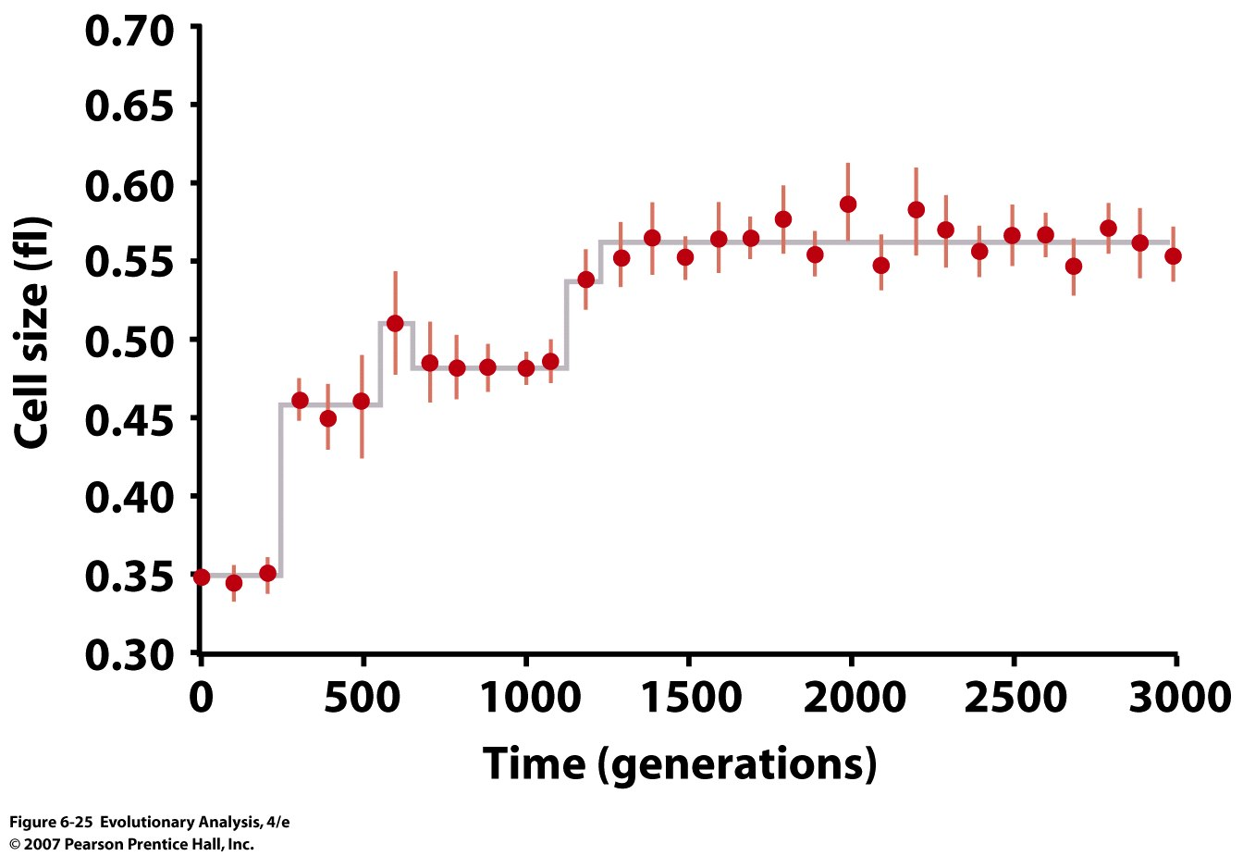
Fruit flies adapt to salt
stress via mutation
Mutations contribute to adaptive
genetic response
Bacterial evolution due to mutation
Notes:
Figure 6.25 Change over time in cell size of an experimental E. coli population
Each point on the plot represents the average cell size in 10 replicate assays of the population. The vertical lines are error bars; 95% of the observations fall within the range indicated by the bars. Reprinted with permission from Elena et al. (1996).

Slide 47
Mutation Selection Balance for a Recessive Allele
q = μ/s
SPECIAL CASE: SELECTION AGAINST LETHAL RECESSIVE:
Examine case of:
telSMN (q=0.01, μ = 1.1 x 10-4) (predicted mutation rate = 0.9 x 10-4)
cystic fibrosis (q =0.02, μ = 6.7x10-7) (predicted mutation rate 2.6 x 10-4)
Sickle cell anemia (q = 0.17)
Notes:
For sickle cell anemia the mutation rate would have to be 0.03, too high

Slide 48
VIII. Conclusions
Population genetic theory supports idea of lots of genetic variation
Population genetic theory supports idea that natural selection can lead to evolution
Evolution allows us to incorporate our understanding of inheritance to also understand pattern of genetic diversity

